Slide 1
Qupls4 Vectors
Nomenclature
Vector instructions are specified by indicating a parallel operation as the instruction suffix.
For example: ADD.P v1,v2,v3,a0 will perform a masked addition of v2 and v3 placing the result in the v1 register. The general-purpose a0 register is being used to hold a mask.
Sized vector operations may also be specified. Example: ADD.WP v1,v2,v3,a0 will add two vectors containing wydes together.

Slide 2
Qupls4 Vectors
Vector Register File
Vector registers are aliased with general purpose registers.
Vector registers may be 64, 128, 192, 256, 320, 384, 448 or 512 bits wide.
64-bit vectors use just a single 64-bit register, 128 vector registers available
128-bit vectors use even,odd pairs of 64-bit registers, 64 vector registers available
192-bit vectors use three out of groups of four registers. 32 vector registers are available
256-bit vectors use groups of four registers, 16 vector registers are available.
320-bit vectors use five out of groups of eight registers. 8 vector registers are available.
384-bit vectors use six out of groups of eight registers. 8 vector registers are available.
448-bit vectors use seven out of groups of eight registers. 8 vector registers are available.
512-bit vectors use groups of eight registers. 8 vector registers are available.
The width of a vector register in use is determined by the number of elements in the register (set in the vlen register) and the vector element size in the VELSZ register. The two quantities are multiplied together then rounded to 64-bit increments. Example: 7 x 32 bit elements needs 224 bits, which is rounded to 256 bits. So, 256-bit vectors would be used, which uses a group of four registers.

Slide 3
Qupls4 Vectors
Special Vector Registers (CSRs)
VELSZ register
This register sets the size of a vector lane (or element).
Valid sizes are 8,16,32 or 64 bits for integers or 16,32,64 or 128 bits for floats.
VLEN register
Specifies the vector length in terms of lanes.
Vectors have a maximum length of 64 lanes.
The product of VELSZ x VLEN cannot exceed 512.

Slide 4
Qupls4 Vectors
Masked Execution
Vector operations may be masked so that only the lanes specified are updated during a calculation.
Mask patterns are stored in scalar general-purpose registers.
The usual integer instructions may be used to manipulate values.
Masks may also be computed using vector SET instructions: SEQ.P, SNE.P, SLT.P, SLE.P, SLTU.P, SLEU.P

Slide 5
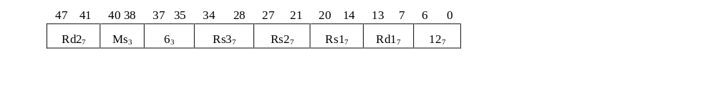
Qupls4 Vectors
VSHLV - Vector Shift Left Vector (Vector Slide Up)
This instruction shifts the elements of vector upwards placing the carry out in a scalar register, and inputting
The carry in from a scalar register. This instruction may also perform a wide left shift operation, shifting by an arbitrary number of bits. To shift by elements Rs2 should be loaded with a multiple of the element size.
Instruction Format:
Rs1 (vector)
Rs3 (scalar)
Lane 3
Lane 2
Lane 1
Lane 0
Carry In
Carry out
Lane 3
Lane 2
Lane 1
Lane 0
Rd2 (scalar)
Rd (vector)

Slide 6
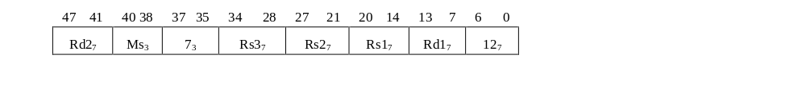
Qupls4 Vectors
VSHRV - Vector Shift Right Vector (Vector Slide Down)
This instruction shifts the elements of vector downwards placing the carry out in a scalar register, and inputting
The carry in from a scalar register. This instruction may also perform a wide right shift operation, shifting by an arbitrary number of bits. To shift by elements Rs2 should be loaded with a multiple of the element size.
Instruction Format:
Rs3 (scalar)
Rs1 (vector)
Carry In
Lane 3
Lane 2
Lane 1
Lane 0
Lane 3
Lane 2
Lane 1
Lane 0
Carry out
Rd (vector)
Rd2 (scalar)

